Slide 1
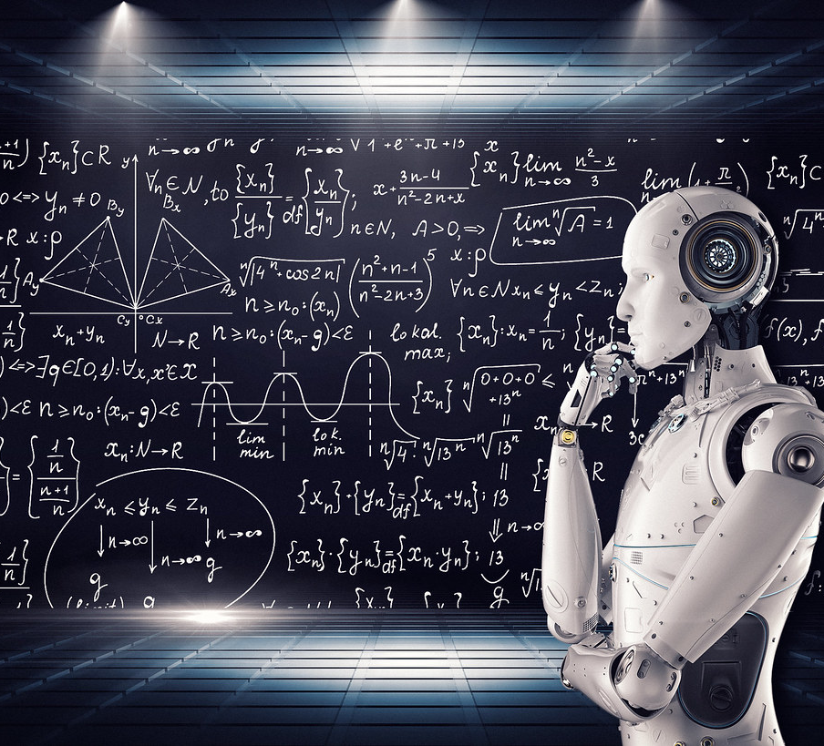
Medical School optional course
Introduction to Machine Learning in Healthcare

Slide 2
Introduction to Machine Learning in Healthcare
Intro and more

Slide 3







Team of instructors
Francisca Leite
PhD in Medical Engineering and Medical Physics
Proud of going back to school at 40+
Wants to be able to do a stable handstand and some other weird yoga postures
Nuno André Silva
PhD in Biomedical Engineering
Proud of his Mafra roots
Wants to learn something new each day
José Maria Moreira
PhD in Biomedical Engineering
Proud of his team ☺
Wants to travel to Japan
Bernardo Neves
MD in Internal Medicine
PhD Candidate in Data Science
Proud of his 3 daughters
Wants to play at Carnegie Hall
Simão Gonçalves
MSc in Analysis and Engineering of Big Data Proud to consistently practice and improve on the piano Wants to be able to buy a house (in this economy...)
Jorge Cerejo
MSc in Biomedical Engineering
Proud of having completed a marathon (and a proud Sporting fan!)
Wants to travel to Southeast Asia
João Pereira
PhD in Brain Imaging
Proud of having taught Biostat so well, his students want to study ML
Wants to have his students singing the Greek alphabet ;)

Slide 4
Your expectations for the course
What do you already know about machine learning and AI?
What do you hope to learn?
How do you see these technologies impacting your future careers in medicine?

Slide 5
Course objectives
Foundational Understanding: Provide students with a foundational understanding and intuition for machine learning by introducing key mathematical concepts
Proactive Learning: Highlight the significance of identifying gaps in knowledge and understanding how this awareness will steer their future learning in machine learning and AI
Practical Skills: Familiarize students with Python and enable them to conduct hands-on experiments to reinforce theoretical concepts

Slide 6
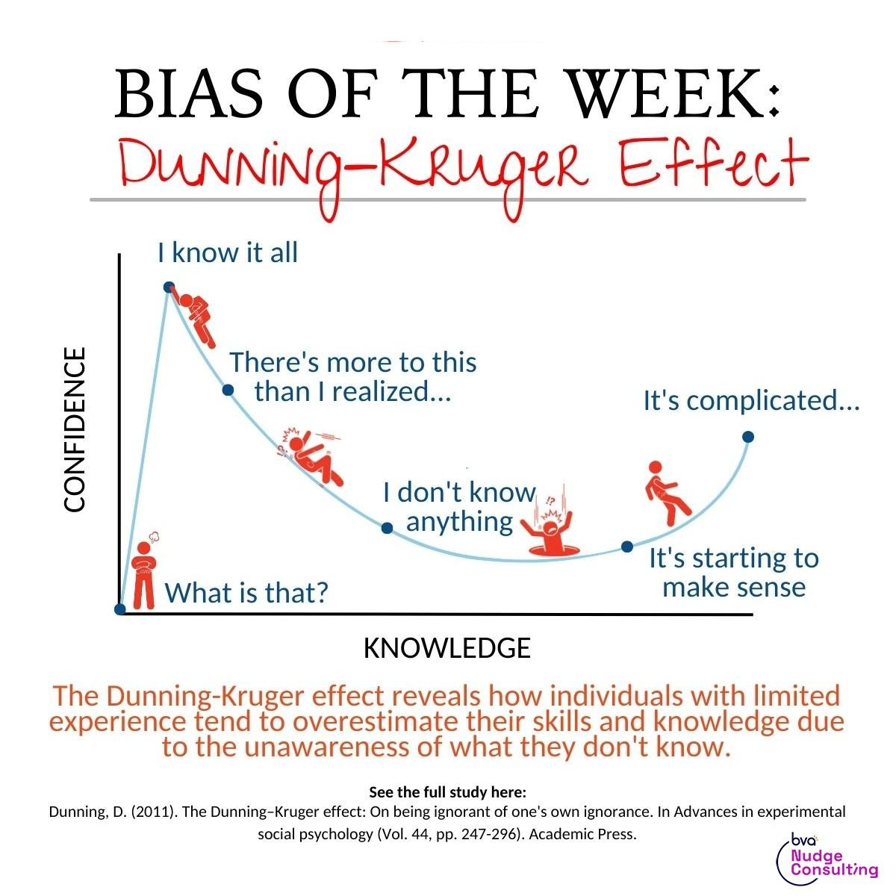
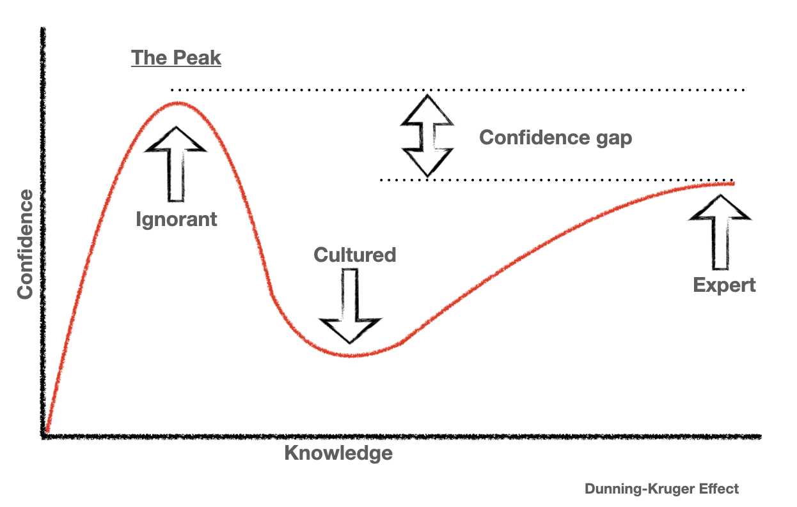
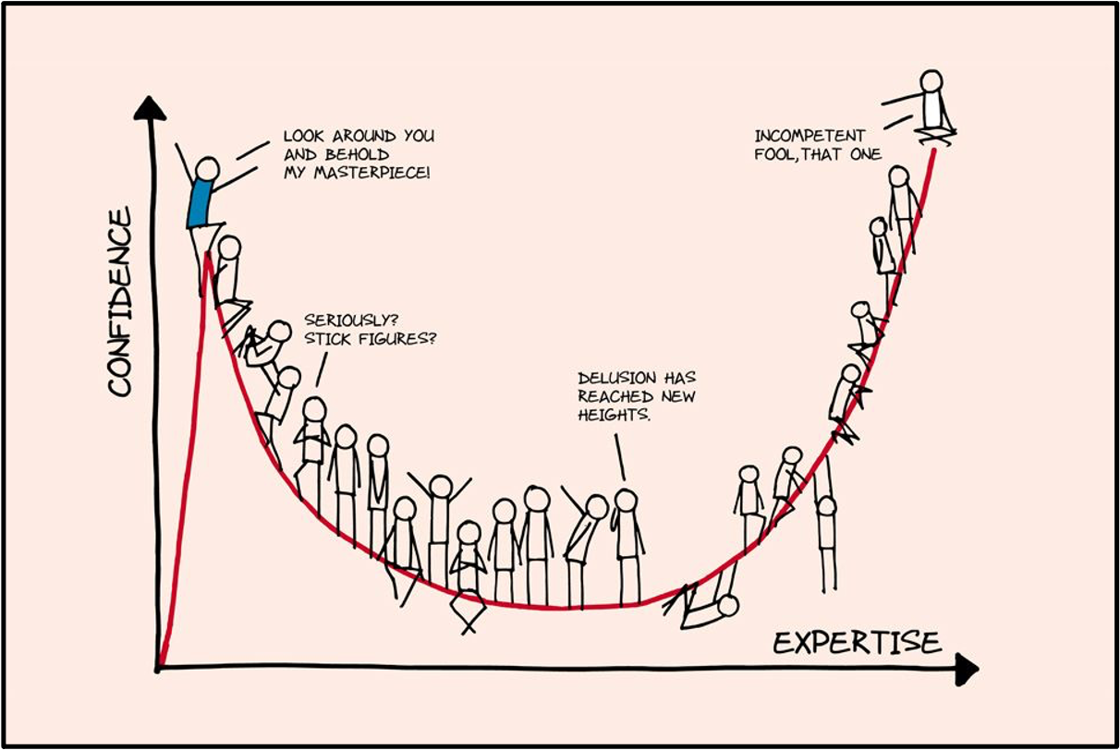

Slide 7
Clearly define concepts: ML and AI
What is Machine Learning?
Machine learning is a subset of artificial intelligence that focuses on building systems that can learn from and make decisions based on data, relying on statistical models
Imagine having a tool that can analyze large amounts of medical data, identify patterns, help predict patient outcomes or suggest treatment options, and getter better with time – this is what ML can do!
What is Artificial Intelligence?
Artificial intelligence, or AI, is a broader concept where machines are designed to perform tasks that typically require human intelligence, including reasoning, problem-solving, understanding natural language, perception, and decision-making
AI encompasses various techniques and approaches, including rule-based systems and logic, among others…

Slide 8
Types of AI in terms of techniques used by chatGPT
Machine Learning (ML): Machine learning is a subset of AI that enables systems to learn and improve from experience without being explicitly programmed. It focuses on the development of algorithms that can analyze data, make predictions, and learn patterns from data. It includes Supervised Learning, Unsupervised Learning and Reinforcement Learning.
Deep Learning: Deep learning is a specialized subset of machine learning inspired by the structure and function of the human brain's neural networks. It involves algorithms known as artificial neural networks that can learn from large amounts of data. It includes Convolutional Neural Networks (CNNs), Recurrent Neural Networks (RNNs) and Transformer Networks.
Natural Language Processing (NLP): NLP focuses on enabling machines to understand, interpret, and generate human language in a way that is meaningful. Techniques include Tokenization, Named Entity Recognition (NER) and Sentiment Analysis
Computer Vision: Computer vision enables machines to interpret and understand visual information from the world. Techniques include Object Detection, Image Classification and Semantic Segmentation.
Expert Systems: These are AI systems that emulate the decision-making ability of a human expert. They use rules and logic to process data and provide recommendations or decisions.
Genetic Algorithms: These are optimization techniques inspired by the process of natural selection. They are used to find optimal solutions to complex problems by evolving better solutions over time.
Fuzzy Logic: Fuzzy logic allows for approximate reasoning in situations where information is incomplete or uncertain. It deals with degrees of truth rather than absolute values.
Knowledge Representation and Reasoning: Techniques for representing knowledge about the world and using it to solve complex problems. Examples include ontologies and semantic networks.

Slide 9
Types of AI in terms of final objective by chatGPT
Prediction and Forecasting: AI techniques are used to make predictions about future outcomes based on historical data. This is common in areas like weather forecasting, stock market prediction, and disease progression in healthcare.
Classification and Recognition: AI techniques classify input data into categories or recognize patterns within data. Examples include image classification (identifying objects in images), speech recognition, and spam email detection.
Optimization: AI techniques are used to optimize processes or systems to achieve the best possible outcome. This includes optimizing supply chain logistics, scheduling tasks, and resource allocation.
Decision Making: AI techniques support decision-making processes by providing insights, recommendations, or automated decision-making based on data analysis. This is seen in automated trading systems, medical diagnosis support, and personalized recommendation systems.
Natural Language Understanding: AI techniques enable machines to understand and generate human language. This is applied in virtual assistants like Siri and Alexa, language translation tools, and sentiment analysis in social media.
Control and Automation: AI techniques are used to control autonomous systems and automate tasks that traditionally require human intervention. Examples include self-driving cars, industrial robots, and smart home devices.
Learning and Adaptation: AI techniques facilitate systems that can learn from data and adapt to changes in their environment. This includes adaptive learning systems in education, personalized medicine, and anomaly detection in cybersecurity.
Creativity and Generation: AI techniques can generate new content, such as art, music, and text, based on learned patterns and styles.

Slide 10
Course outline

Slide 11
Areas of Mathematics
Arithmetic: The study of numbers and basic operations such as addition, subtraction, multiplication, and division.
Geometry: The study of shapes, sizes, and the properties of space.
Number Theory: The study of integers and integer-valued functions.
Algebra: The study of symbols and the rules for manipulating these symbols; it includes solving equations and understanding abstract structures.
Trigonometry: The study of relationships involving lengths and angles in triangles.
Calculus: The study of change and motion, through derivatives and integrals.
Probability and Statistics: The study of data, uncertainty, and the analysis of random phenomena.
Set Theory: The study of sets, which are collections of objects.
Mathematical Logic: The study of formal logical systems and their applications in mathematics.
Linear Algebra: The study of vectors, vector spaces, linear transformations, and matrices.
Topology: The study of properties of space that are preserved under continuous transformations.
Complex Analysis: The study of functions of complex variables.
Differential Equations: The study of equations involving derivatives and their solutions.
Discrete Mathematics: The study of mathematical structures that are fundamentally discrete rather than continuous.
Numerical Analysis: The study of algorithms for performing numerical computations.

Slide 12
Introduction to Machine Learning in Healthcare
Brief history of AI and Machine Learning

Slide 13
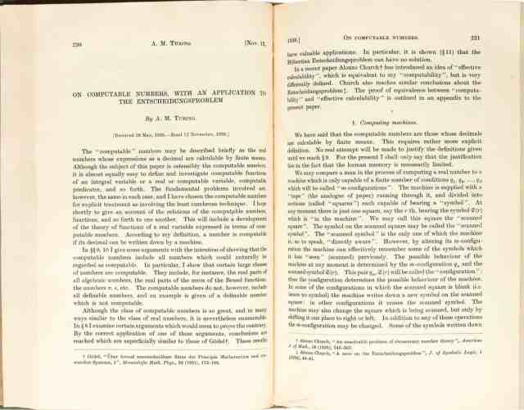
“Universal machine”
The concept of machines that can think dates back to the mid-twentieth century!
In 1936, Alan Turing proposed the idea of a 'universal machine' and introduced the Turing Test to determine if a machine could exhibit intelligent behavior equivalent to, or indistinguishable from, that of a human

Slide 14
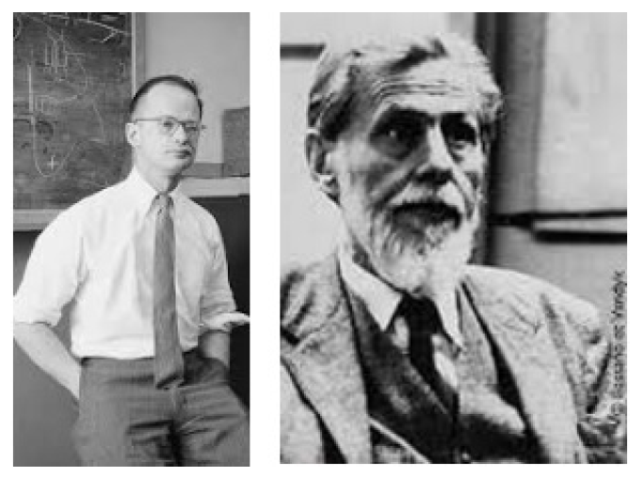
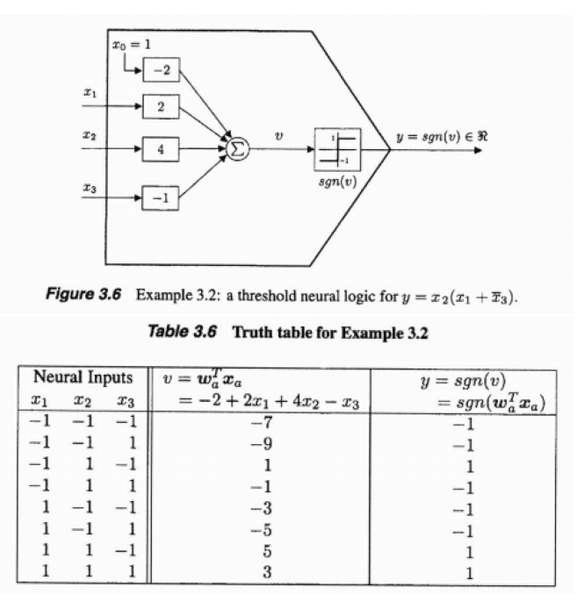
Earliest computational model of a neuron
Warren McCulloch and Walter Pitts
1943

Slide 15
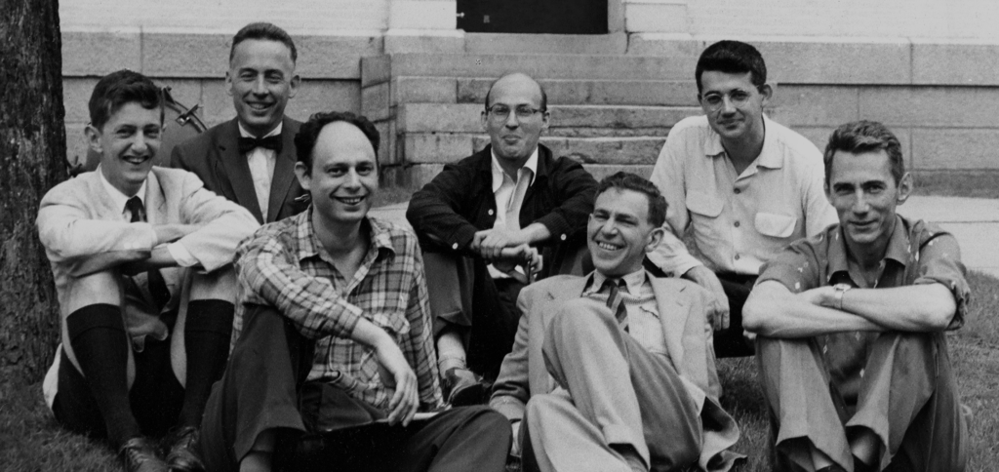
The Birth of AI: the Dartmouth conference
The main objective of the Dartmouth Conference was to explore the possibility of creating machines that could simulate human intelligence
The proposal for the conference stated that "every aspect of learning or any other feature of intelligence can in principle be so precisely described that a machine can be made to simulate it.”

Slide 16
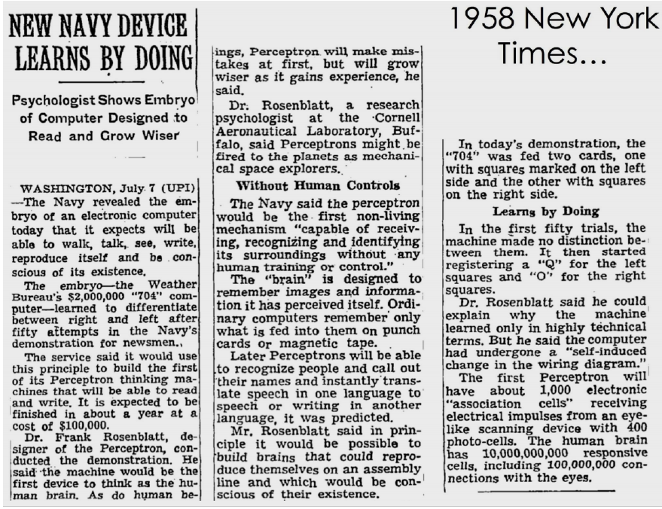
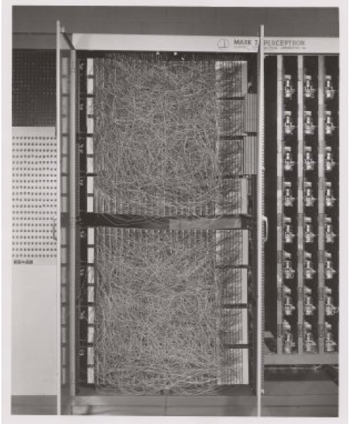
The perceptron
Invented by Frank Rosenblatt in 1957 at the Cornell Aeronautical Laboratory
Implemented in custom-built hardware as the “Mark 1 perceptron” for image recognition
400 photocells, randomly connected to the “neurons”
Weights were encoded in potentiometers and weight updates during learning were performed by electric motors

Slide 17
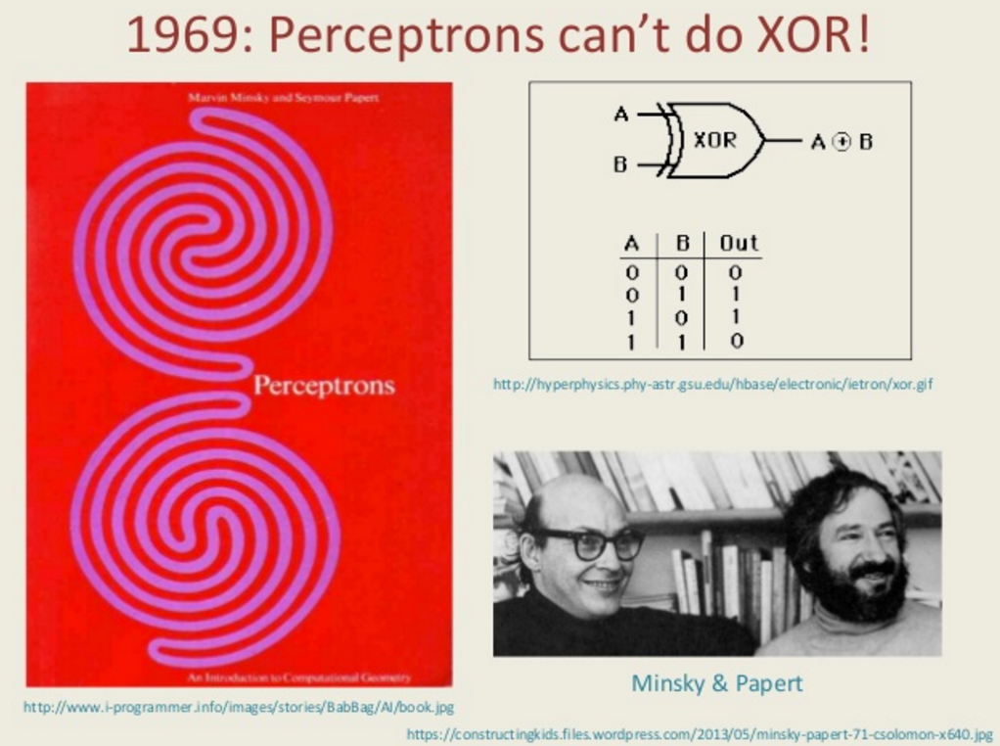
AI winter
While Minsky's work contributed to a more realistic understanding of the limitations of early AI approaches, it was not the sole cause of the AI winter
The AI winter resulted from a combination of high expectations, technical limitations, critical evaluations and the subsequent reduction in funding and interest in the field

Slide 18
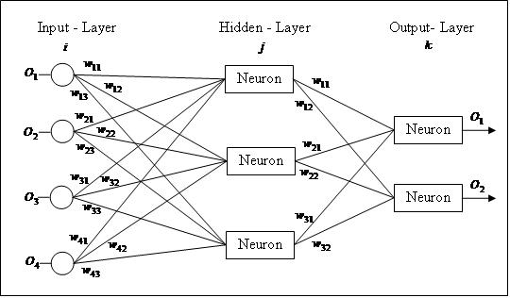
AI resurgence: Backpropagation
The concept of backpropagation, a method for training artificial neural networks, was initially developed in the 1960s
It was further refined and popularized in the mid-1980s
A pivotal paper by David E. Rumelhart, Geoffrey E. Hinton, and Ronald J. Williams, published in 1986, titled "Learning representations by back-propagating errors," detailed the backpropagation algorithm and demonstrated its effectiveness for training multi-layer neural networks

Slide 19
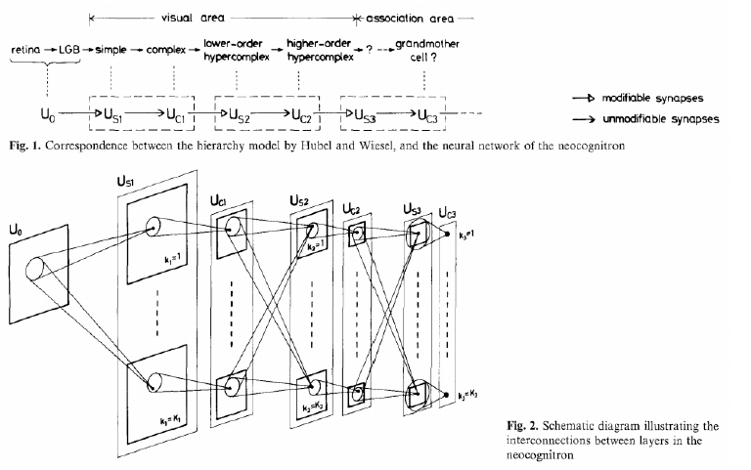
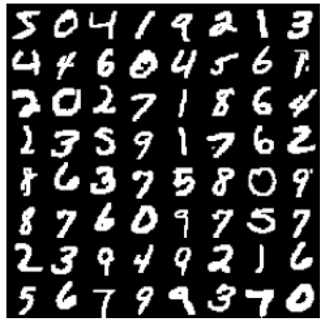
AI resurgence: Neurocognitron
Fukushima and Miyake in 1982
Inspired by the multi-stage hierarchy model of the visual nervous system by Hubel and Wiesel, 1965
ConvNet successes: MNIST with 0,35% error

Slide 20
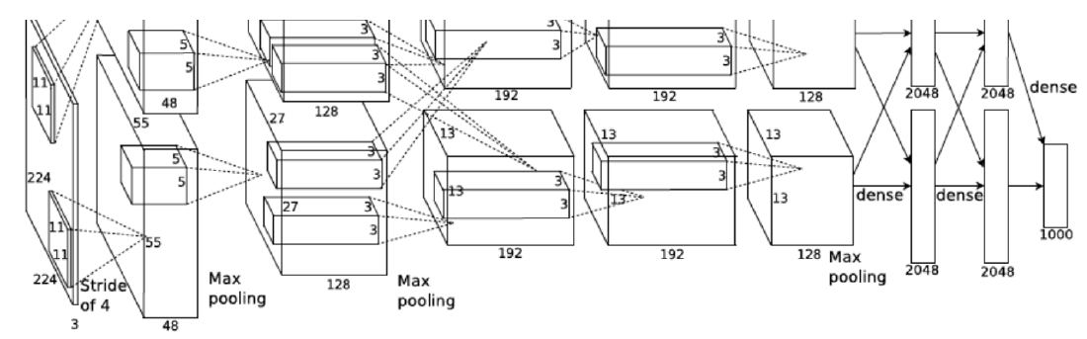
Rise of Deep Learning: AlexNet
Alex Krizhevsky, Ilya Sutskever, Geofrey Hinton 2012
54M parameters, 8 layers (5 conv, 3 fully-connected)

Slide 21


Rise of Deep Learning: AlexNet
14 197 122 labelled images, 20 000 categories

Slide 22
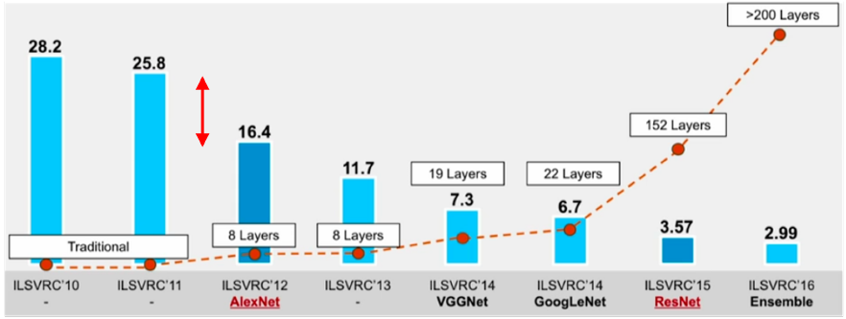
Rise of Deep Learning: AlexNet

Slide 23
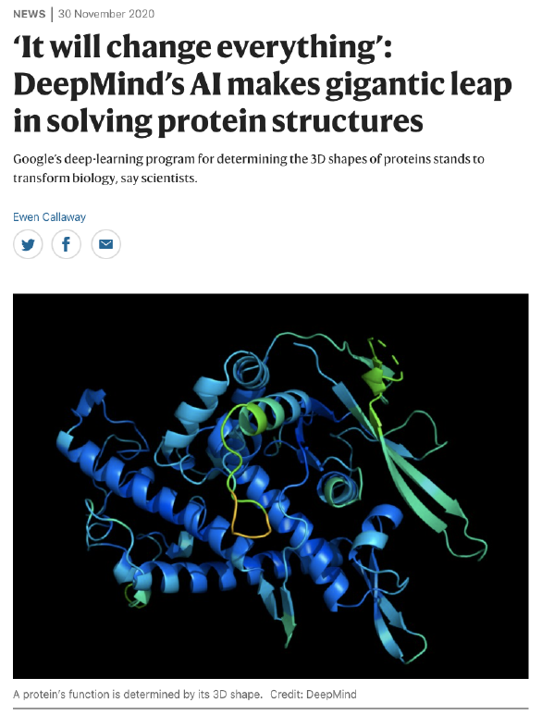
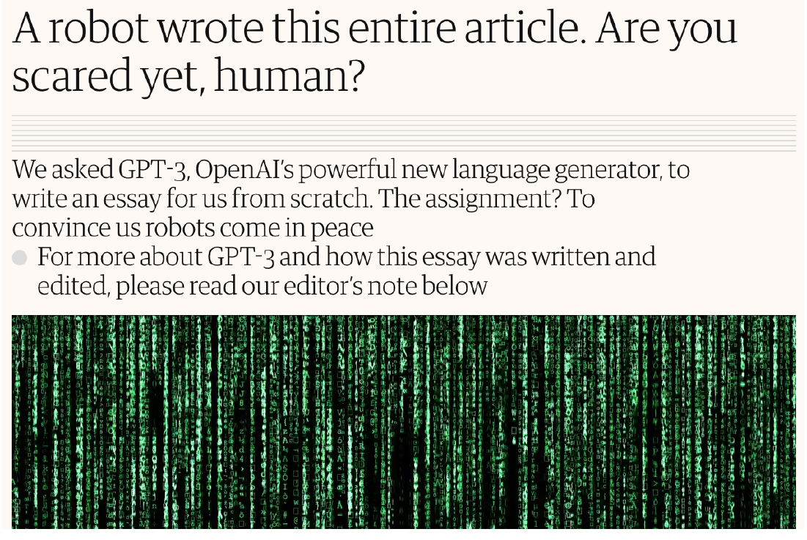
Exponential evolution?

Slide 24
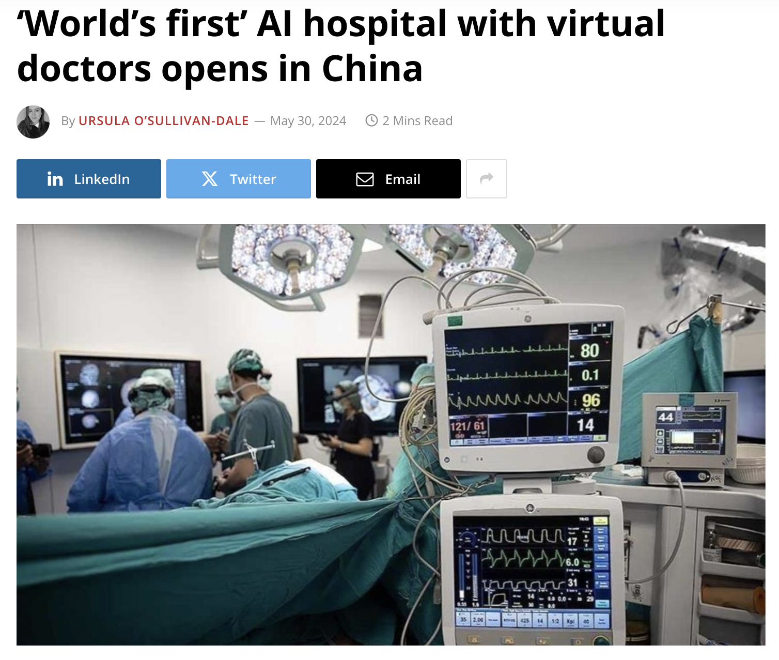
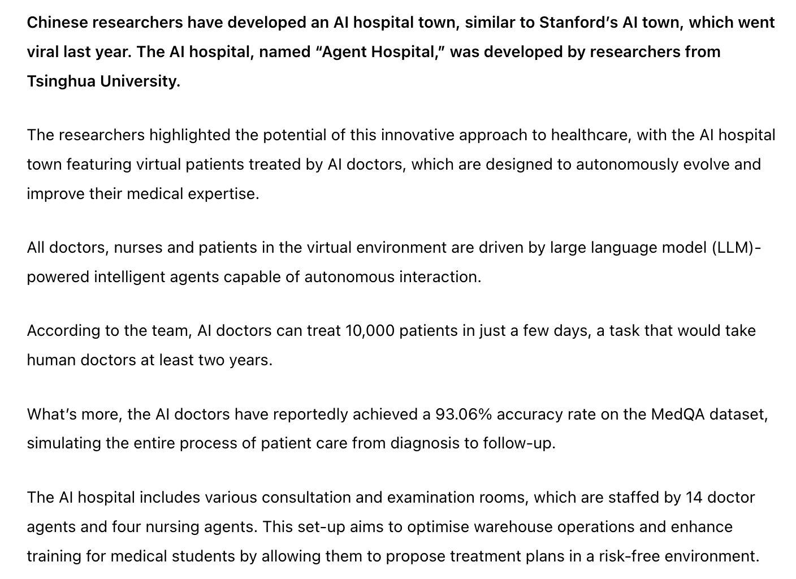
Will AI replace us?

Slide 25
Introduction to Machine Learning in Healthcare
A brief introduction to Python

Slide 26
Why Python?
Ease of learning: Python is known for its simplicity and readability, making it easier for beginners to grasp fundamental programming concepts
Versatility: Libraries like NumPy, Pandas, and Scikit-learn provide powerful tools for data manipulation, analysis, and modelling
Integration with ML Libraries: Python seamlessly integrates with many machine learning libraries and frameworks
Widespread Adoption: Python has gained immense popularity in the field of data science and machine learning, and many industry-standard tools and frameworks, including TensorFlow and PyTorch for deep learning, are primarily developed in Python
Community Support: Python has a large and active community of developers and data scientists, with abundant online resources
Career Relevance: Proficiency in Python is highly valued in the job market…

Slide 27
Introduction to Machine Learning in Healthcare
Tomorrow:
A brief introduction to Linear Algebra and Calculus

